Slide 1
Injury Illness Prevention Program
Topic 1 of 4

Slide 2
3 Men descend to their death, overcome by poisonous gas underground
Miami Herald
…three workers from a private contractor [Higgins] tasked with fixing a roadway climbed into a hole in the ground and, ultimately, to their deaths.
In April, 2002, an Occupational Safety and Health Administration inspection of a Higgins project in a Marco Island manhole resulted in a $2,500 fine that got settled for $1,875.

Slide 3
Regulations
Why
Who
When
Title 8, California Code of Regulations Section 3203(T8 CCR 3203)
Injury/Illness Prevention Program (IIPP)
Every California Employer must have a written program.
A copy must be maintained at each worksite.
Employees must be informed of the IIPP.
How
What
Where
Notes:
Every CA employer must establish, implement and maintain a written IIPP and a copy must be maintained at each worksite or at a central worksite if the employer has non-fixed worksites such as Physical Plant Operations. The requirements for establishing, implementing and maintaining an effective written IIPP are contained in Title 8 of the California Code of Regulations, Section 3203.
Each employee must be aware of the IIPP. This can be accomplished through training, email correspondence, bulletins and other means of communication.

Slide 4
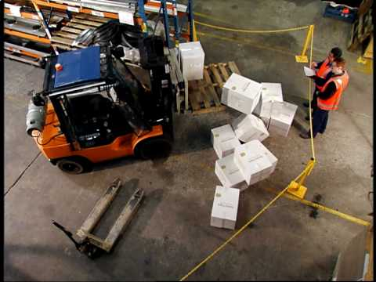
Did You Know
In California there were 334 workplace fatalities in 2014 (396 in 2013 - revised)
In the US, 4,679 workers were killed on the job in 2014 (4,405 in 2013)
Notes:
From Dept of Labor
A 9% increase in fatalities in 2014 from the previous year in the US.
Falls, slips, and trips increased 10 percent to 793 in 2014 from 724 in 2013 (US).
From Bureau or Labor Statistics
Fatal occupational injuries by Metropolitan Statistical Area (MSA), 2014 - San Diego-Carlsbad, CA 26 fatalities
OSHA making a difference
In four decades, OSHA and our state partners, coupled with the efforts of employers, safety and health professionals, unions and advocates, have had a dramatic effect on workplace safety.
Since 1970, workplace fatalities have been reduced by more than 65 percent and occupational injury and illness rates have declined by 67 percent. At the same time, U.S. employment has almost doubled.

Slide 5
Injury Cost to the District
The cost for 2014 & 2015 is the total payments made & includes injuries that may have occurred in previous years and are still open cases that will keep accruing.
Injury cost in 2014
  1,072 injury cases
  $12,227,722.82 ($9,342,966.44 as reported Jan 2015)
Injury cost in 2015
  1450 injury cases
  $13,309,076.89
Notes:
In addition to these direct costs, employers incur a variety of other costs that may be hidden or less obvious when an employee is injured or ill, but in most cases involve real expenditures of budget or time. These expenditures are commonly referred to as indirect costs and can include:
Any wages paid to injured workers for absences not covered by workers' compensation;
The wage costs related to time lost through work stoppage;
Administrative time spent by supervisors following injuries;
Employee training and replacement costs;
Lost productivity related to new employee learning curves and accommodation of injured employees; and
Replacement costs of damaged material, machinery and property.

Slide 6
Incident VS. Accident
Incident
Accident
Is an unplanned, undesired event that adversely affects completion of a task
is an unplanned, undesired event that results in personal injury or property damage.
All accidents are Incidents

Slide 7
Safety Analogy
1
Serious Injury
29
Minor Injuries
300
None-Injury Accidents
3000
Hazards
For every
There Are
Notes:
One study found that for every single fatality there are at least 300,000 at-risk behaviors, defined as activities that are not consistent with safety programs, training and components on machinery. These behaviors may include bypassing safety components on machinery or eliminating a safety step in the production process that slows down the operator. With effective machine safeguarding and training, at-risk behaviors and near misses can be diminished. This also reduces the chance of the fatality occurring, since there is a lower frequency of at-risk behaviors.

Slide 8
Examples of
Serious Injury, Minor Injury, Non-Injury & Hazard
Serious Injury
Minor Injury
Teacher hospitalized when they fall off ladder while hanging artwork causing broken bones
Employee missteps while descending step ladder and twist ankle
Notes:
To move from a reactive approach (after an occurrence) to a proactive approach (prevention) report all incidents. Address all incidents to control and prevent serious incidents.
Safety inspections also help improve safety performance proactively by eliminating or reducing hazards that contribute to injuries, illnesses and property damage.

Slide 9

Examples of
Serious Injury, Minor Injury, Non-Injury & Hazard
Non-Injury Accident
Hazards
Employee leans to one side of ladder to hang art work & it starts to sway
Employee not placing ladder close enough to work area

Slide 10
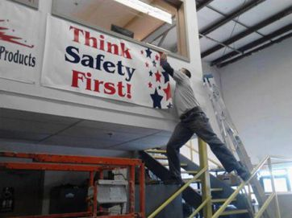
How Does an Injury and Illness Prevention Program Work for You?
Established elements that focus on finding hazards in the workplace
Develop a plan for preventing and controlling those hazards
Management & employees working together are vital in identifying & addressing a safety hazard
You need to be trained about how the program works
NOT A SAFE ACT
Notes:
The program needs to be periodically evaluated to determine whether improvements need to be made

Slide 11




8 Program Elements
Responsibility
Compliance
Communication
Hazard Assessment
Accident & Exposure Investigation
Hazard Correction
Training
Record Keeping
Notes:
CA-OSHA will ask for these two things upon an investigation
Training & Instruction
Record Keeping
The code section requires that the written program consist of the above listed 8 elements.

Slide 12
Responsibility
Superintendent
Administrator
Employee
Safety Office
Overall Responsibility
Site Responsibility
Follow Safety & Health Codes/Regulations
Develop & Maintain Program
Within the District
Notes:
The superintendent has overall responsibility, the Safety Office develops and maintains the program, administrators are responsible for their individual sites or programs, and employees are responsible for following safety & health codes and regulations as well as district policies and procedures.

Slide 13
Employee Compliance
Evaluations
Certificates of appreciation or presentations in front of peer groups recognizing safety acumen
Counseling
Evaluations
Classified employment regulations
Bargaining unit contract language
Notes:
Evaluations contain a section for rating employees knowledge of and adherence to safety policies. Awards can be in the form of memos, certificates and recognition at meetings.
Counseling should be conducted when an employee is observed using unsafe practices or violating procedures. If these actions continue or escalate a special evaluation may be deemed necessary.
The classified employment regulations, article VI, pertains to disciplinary actions, appeals, & hearings. Bargaining unit contract language regarding safety is in article 10 for classified employees, (PARA, OTBS, OSS) and in article 11 for SDEA.
NOTE: Please consult with human resources for questions pertaining to disciplinary procedures.

Slide 14

communication
WRITTEN DOCUMENTATION
Ways to communicate safety
STAFF MEETINGS
You cannot be retaliated against for reporting hazards or potential hazards
POSTINGS
FORMAL & INFORMAL TRAINING
Notes:
Administrators and other supervisory employees are responsible for communicating with employees about occupational safety & health in a form readily understandable by all employees.
In addition, employees must be encouraged to inform administrators or other supervisory employees about workplace hazards without fear of reprisal and may be verbal or written as the employee chooses. Employees may use the Employee Report of Safety Hazard form and remain anonymous. The Employee Report of Safety Hazard form is available on the Safety Management website under “Forms & Labels.”

Slide 15
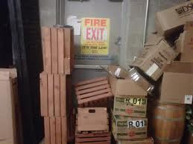
Hazard assessment
Ways to assess a hazard
Semiannual Site Safety Inspection
Safety Data Sheets
Employee report of a safety hazard
What is wrong with this picture?
Notes:
What’s wrong with this picture? The fire exit is blocked.
Periodic inspections to identify and evaluate workplace hazards shall be performed by competent personnel, typically the BSS or POS. In addition there is an employee report of safety hazard form available on the Safety Management website.
Prior to introducing new products or chemicals forward a copy of the SDS to the Safety Office for review to ensure that there are no chemicals banned for use in schools and for evaluation on chemicals that have not been pre-approved for use. The review process will recommend to sites/Dept whether or not the product is allowed for use, banned from use or allowed with certain precautions.

Slide 16
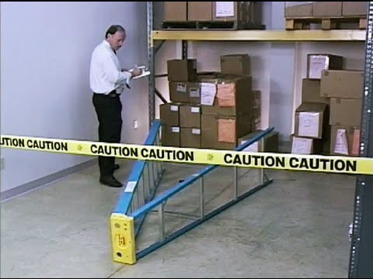

Accident investigation
If you are in an accident or have an injury the district is required to fill out the following:
Form 78 – Supervisors report of injury/illness
Workers’ Compensation Claim Form (DWC-7) must be provided within twenty-four (24) hours of knowledge of any work-related injury or illness
Witness statements
If injured after normal business hours and you go to the hospital other than for first aid or observation then you must report the injury to the closest CA-OSHA office
Notes:
The above listed forms should be used to document any and all injuries or accidents.
If you are in an accident or have an injury the district is required to fill out the following:
Form 78 – Supervisors report of injury/illness
Workers’ Compensation Claim Form (DWC-7) must be provided within twenty-four (24) hours of knowledge of any work-related injury or illness
Witness statements
There is a guideline for basic rules for accident investigation that is part of district’s written IIPP and is available on the Safety Management website.
Workers' compensation law requires that the District immediately send to the State of California specific information electronically for every work-related injury/illness that results in lost time beyond the day of injury or requires medical treatment other than first aid, thus it is important to notify the Risk Management Dept. immediately when someone is injured.
If an injury occurs after normal business hours and you go to the hospital other than for first aid or observation then you must report the injury to the closest CA-OSHA office which is in San Diego within an 8 hour period or as soon as feasibly possible.

Slide 17
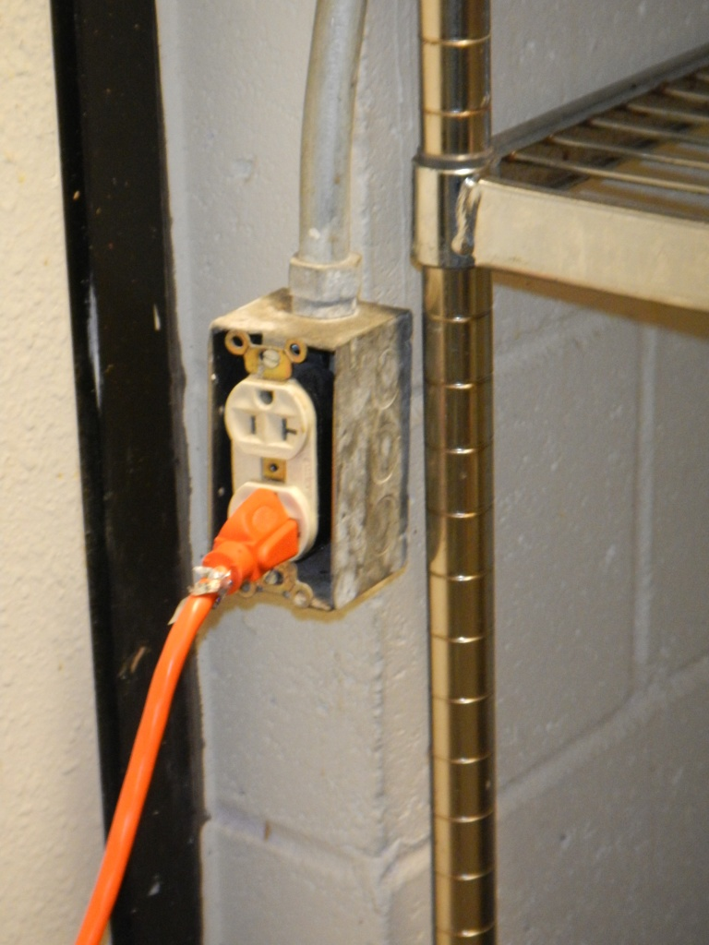
Correcting a hazard
Minor hazards may be corrected by site staff & some hazards require assistance from:
Physical Plant Operations
Safety Office
Outside Contractors, Vendors or Consultants
Can you see a problem?
Notes:
Hazard in the picture: MISSING OUTLET COVER
When hazards are identified they should be addressed immediately. If the hazard is beyond a sites means or ability to correct, steps should be taken to limit access to the hazard by use of barriers and warning signs. Contact Physical Plant Operations for assistance. Outside consultants and/or vendors may be required for some hazards requiring specialty certifications or equipment.

Slide 18

Training for you
If you are a new employee
Prior to new job assignments
When new substances, processes, procedures or equipment are introduced to the workplace
Whenever the employer is made aware of a new or previously unrecognized hazard
All workers on job specific hazards
Notes:
The Safety Office has training topic material available on the Safety Management website or we can send material via email and are able to assist you with your training requirements.
Site administrators or supervisors must provide training:
New Employees
Prior to new job assignment
When new substances, process, procedures or equipment are introduced to the workplace
All employee training must be documented, use sign-in sheets – Keep for 3 years

Slide 19

What training is required?
Injury Illness Prevention Program (IIPP)
Hazard Communication (HAZCOM)
Bloodborne Pathogen (BBP)
Fire Safety
There are other areas of safety that may be more specific for the area you work in and would be covered as a job specific type training

Slide 20


Recordkeeping
Lastly
For Supervisors
Supervisor’s Report of Accident/Injury
Inspection Forms
Training
Accident Investigations
Employees
Remember you need to sign-in when receiving training
Notes:
The code requires that these documents be maintained at the site for 3 years. Ensure that prior to sending inspection forms to maintenance (PPO), you make a copy and keep it in a central location along with copies of the other records listed above.
NOTE: If your site is inspected by CA/OSHA you will be required to produce the documents and provide copies to the inspector.

Slide 21
Topic 2
Bloodborne Pathogens

Slide 22

Bloodborne Pathogens (BBP)

Slide 23
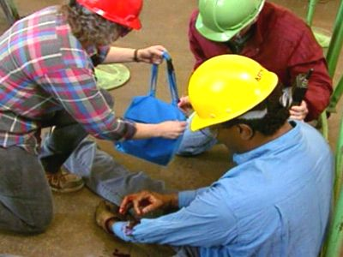


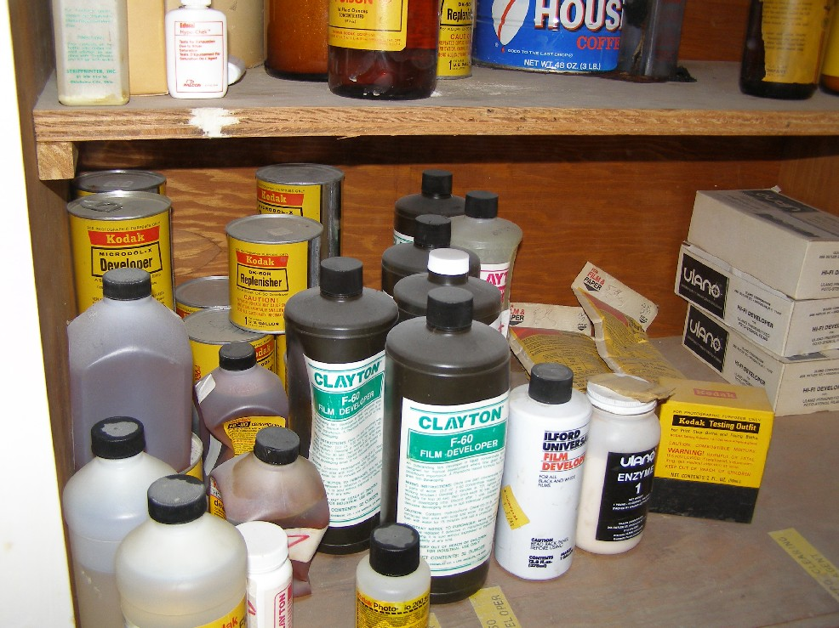
The Regulations
Cal/OSHA mandates that employees with occupational exposure are informed at the time of initial assignment and at Least Annually
A standard was published to reduce or eliminate health risk, resulting in:
  Annual training
  Safe workplace environment
  Exposure Control Plans

Slide 24
SDUSD Exposure Control Plan
Written by the school district to satisfy Cal/OSHA guidelines
  Defines who is at risk
  Outlines procedures to minimize or eliminate exposures to blood- borne diseases
  Procedures to follow in event of exposure
Available on the district website
  Bloodborne Pathogen Program https://www.sandi.net/staff/sites/default/files_link/staff/docs/safety-management/SDUSD%20Bloodborn%20Pathogen%20Program_0.pdf
  Cal/OSHA http://www.dir.ca.gov/title8/5193.html
Purpose is to ensure employees are aware of potential hazards related to bloodborne pathogens and how to avoid them

Slide 25

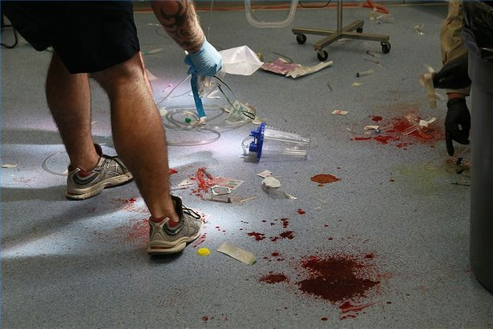
What BBP
Bloodborne = found in blood
Pathogen = disease producing microorganism
May be present in:
Blood
Body fluids - semen, vaginal secretions, broken skin, saliva & vomitus (when visibly contaminated with blood)
Notes:
Bloodborne Pathogens can cause infection by entering your body through: open cuts and nicks; skin abrasions; dermatitis (if skin is broken); acne; mucous membranes of your mouth, eyes, nose or vagina.

Slide 26
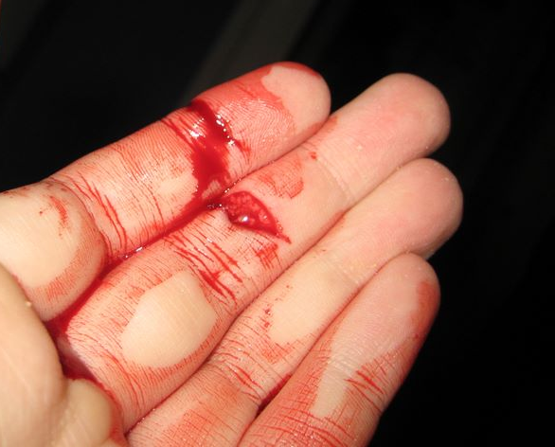
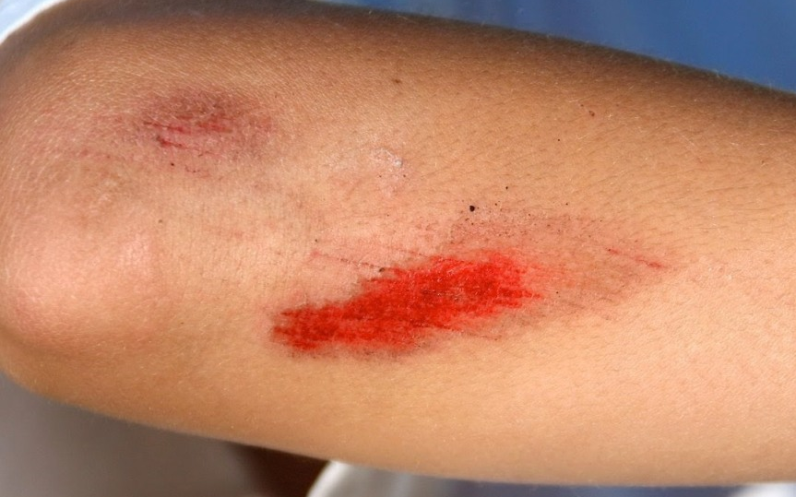
Bloodborne Pathogens
May cause infection by entering your body via:
Open cuts and nicks
Skin abrasions
Dermatitis – when skin is broken
Mucous membranes – mouth, eyes, nose or vagina

Slide 27
Hepatitis Inflammation of the Liver
Common types of Hepatitis in the US | Mode of Transmission
A | Fecal-Oral
B | Bloodborne
C | Bloodborne
D | Bloodborne
Notes:
Hepatitis D is exists only in the presence of hepatitis B.
More than 5 million people in the U.S. have hepatitis. Excessive alcohol use, certain chemicals or drugs, and viruses can cause the disease.

Slide 28

Understanding the Liver
Stores vitamin & minerals
Makes bile to digest food
Detoxifies poisonous chemicals (alcohol, drugs)
Stores energy
Manufactures proteins
Removes inhaled poisons
Makes clotting factors
Helps defend body from germs
Notes:
The liver is a non-complainer – signs and symptoms of problems do not usually appear until damage is done

Slide 29
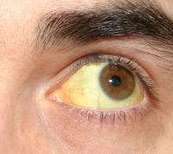
Signs & Symptoms of Hepatitis
Nausea and vomiting, Fatigue, Loss of appetite, Abdominal pain, Diarrhea, Yellowing of eyes and skin, Dark colored urine, Light colored stools
Notes:
People with hepatitis may exhibit any or all of these symptoms. The last 3 are typically seen in later stages

Slide 30


Hepatitis A
Not a Bloodborne Pathogen
Contracted by
  Eating food or drinking liquids contaminated with human feces
  Not washing hands after using bathroom and diaper changing
Rates have declined 92% since the vaccine became available in 1995
Vaccine consists of two doses given 6 months apart
Notes:
San Diego County is a high risk area. Vaccination is also recommended for anyone who travels to countries with high rates of Hepatitis A (Mexico, Caribbean, South America, Africa). Vaccine doses are given 6-18 months apart, and it takes 30 days to become effective.

Slide 31

Hepatitis B
Serious and sometimes fatal disease
Virus can live on a dry surface for 7 days
There are 500 million Hepatitis B virus particles in a single teaspoon of blood
Contracting Hepatitis B increases chance of developing cirrhosis & liver cancer
It is recommended that SDUSD employees working with blood and/or body fluids on a regular basis get the Hepatitis B Vaccine Series
Vaccine is no longer available through District – see note section
Notes:
Vaccines are no longer available through the District. You should contact your medical provider or you may be able to contact San Diego County Office of Human & Health Services at 1-866358-2966 or go to their website at https://www.sandiegocounty.gov/hhsa/programs/phs/immunization_branch/immunization_clinic_schedule.html.

Slide 32

Transmitted through blood or sexual contact
  Can be spread via toothbrushes and razors
100 times more infectious than HIV
Estimated one million people in the United States have chronic Hepatitis B infection, with 350 million people affected worldwide
Notes:
Can be spread via toothbrushes and razors – although this is rare, or if infected saliva enters an open wound. Small cuts, sores, or tiny breaks in your skin can be doorways for Hep B or HIV virus to enter your body

Slide 33
District Category 1 Employees
School Nurse & Health Office staff
School Police
Speech Pathologists
Special Education staff
School site secretaries/clerks who assist in the Health Office
Infant Center (SEEC) and Home Health Staff
Coaches, Athletic Program & Physical Education staff
Custodial staff
R.O.P. and Community Education Program staff
Bus Transportation staff

Slide 34
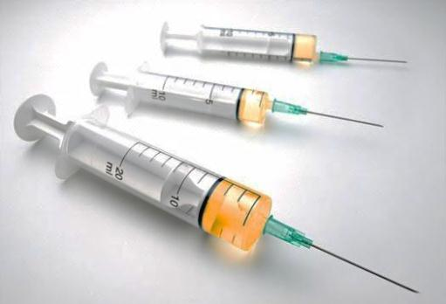
Hepatitis C
Primarily transmitted through blood-to-blood contact, though also associated with use of intranasal cocaine
4 times more prevalent than HIV
10 times more infectious than HIV
75% of people have no early symptoms
Increases risk of cirrhosis, liver cancer & liver failure
No vaccine available
#1 reason for liver transplants in the US
Notes:
#1 reason for liver transplants in the U.S.
Blood-to-blood contact most commonly through shared needles, and blood transfusions and transplants received before 1992,

Slide 35
Human Immunodeficiency Virus (HIV)
Transmitted through blood-to-blood contact, unprotected sexual contact or mother to baby
Requires direct exposure of infected blood to broken skin, mucous membranes or into the bloodstream
No reported cases of transmission in the school setting
No vaccine available

Slide 36
HIV is NOT Transmitted By
Shaking hands
Insect bites
Eating utensils
Toilets
Furniture
Hugging
Sneezing/coughing
Other casual contact that does not permit exchange of body fluids
HIV

Slide 37
HIV is NOT Transmitted By:
Anonymous | Confidential
No name, no record, no fee | Results go in your medical chart
For more Info: County of San Diego (619) 296-2120 | Through your private physician/provider

Slide 38
HIV Testing & the Law
Results cannot be used to determine employability or insurability
You cannot be forced to be tested
It is a misdemeanor to disclose positive results without the WRITTEN consent of the individual. Consent available from school nurse (on Nursing eTeams)

Slide 39
Communication of HIV Statis in the Schools
Parent and student may choose not to disclose HIV status to anyone
If they tell the school nurse, but choose not to consent to disclosure to anyone else, no one else will know
If they authorize disclosure, authorized people will be notified on a need-to-know basis once the diagnosis has been confirmed
Notes:
It is very possible that there may be a student who is HIV positive in the school and no one knows. Depending on the age of the student, and how it was transmitted, they might not even know.

Slide 40

Universal Precautions
Precautions/guidelines appropriate for preventing the spread of ALL infectious disease
Treat ALL blood and body fluids as infectious
Hand washing is the number one method in controlling communicable disease

Slide 41
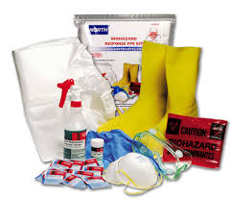
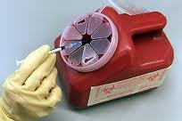
Universal Precautions
Use gloves and other protective equipment when there is risk of exposure to blood or body fluids, regardless of whether you think a person is infected or not.
Contaminated trash is to be disposed of in a properly labeled, plastic lined container
All needles, lancets and syringes are to be disposed of in a “sharps” container
Notes:
So, since there is no way of knowing whose blood might be infected, it is crucial that you follow universal precautions all the time

Slide 42
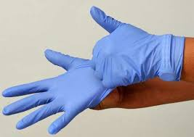
Personal Protective Equipment (PPE) - Gloves
Wear non-latex disposable gloves
Wear gloves when rendering first aid and exposed to blood/body fluids blood other than your own
Wear only once
Replace if torn/punctured
Dispose of in properly marked container
Wash hands after removing - Gloves are not a substitute for hand washing!

Slide 43



Personal Protective Equipment (PPE) – Eye & Mouth Protection
Eye & Mouth Protection shall be worn whenever splashes, spray or spatter may be generated; and eye, nose or mouth contamination can be reasonably anticipated

Slide 44

Hand Protection
For 15-30 seconds with soap and running water
Before and after touching someone or something potentially infectious
Before eating, drinking, cooking, applying cosmetics or handling contact lens
After toileting/diapering, contact with body fluids, or removing gloves

Slide 45

What would you do if you see blood on the floor?
Would you wipe it up using no hand protection?
Or would you stop & take the time to put on gloves?

Slide 46

Disinfectant
Household chlorine bleach –a solution of 10 parts water to one part bleach
Mix ¼ cup bleach in bottle filled to 1 gallon
Mix fresh daily
Effective against HIV, Hepatitis B & most other disease causing organisms

Slide 47
If you are exposed to blood on…
Skin | Wash with non-abrasive soap & water
Eyes | Flush with running water for at least 15 seconds
Mucous Membranes | Flush with water
Notes:
Hopefully this won’t happen, because you will all be following universal precautions, but if it does…..
Use non-abrasive soap because you do not want to potentially damage your skin and make a portal for the virus to enter your body if there isn’t already one there.

Slide 48
Post Exposure Protocol
Complete a First Aid Incident Report (Appendix C -district’s Exposure Control Plan) & submit it to the school secretary before the end of the day
Log entry in Sharps Injury log, if applicable
Within 24 hours, obtain medical evaluation and treatment at one of the district’s contracted occupational health sites

Slide 49
Resources
http://www.cdc.gov/hepatitis/
http://www.cdc.gov/hiv/
http://www.sdcounty.ca.gov/hhsa/programs/phs/hiv_std_hepatitis_branch/hiv_counseling_and_testing_services.html
SDUSD Nursing & Wellness
https://www.sandi.net/staff/nursing-and-wellness-program/nursing-and-wellness

Slide 50

Please contact your school nurse with any questions about Bloodborne Pathogens (BBP)

Slide 51
Topic 3
Hazard Communication

Slide 52

Hazard Communication for Hazardous Materials including
Antimicrobials
(Sanitizers and Disinfectants)

Slide 53
Cal/OSHA
T8 CCR 5194
For Hazardous Materials
DPR
T3 CCR 6700
For Antimicrobials
  Protect employees from hazardous chemicals
Inform employees about chemical hazards
Teach precautions and protective measures when using, handling & coming into contact with chemicals
Ensures that employees are aware of potential hazards in the workplace and are trained to deal with them
Provide appropriate safety equipment
Post written pesticide safety information for staff

Slide 54

Program Elements for
Handling Chemicals
Have a written Hazard Communication Program HAZCOM
Ensure that information is available for the chemicals
  Safety Data Sheets (SDS)
Ensure that the chemicals are properly labeled
Chemicals are regularly inventoried
Training is adequate
Recordkeeping

Slide 55
Program Elements for
Handling Antimicrobials
Provide a safe workplace
Require employees follow safe work practices
Have a written Illness and Injury Plan IIPP
Ensure that employees handle chemicals and pesticides safely

Slide 56
What Are Antimicrobials
Can kill or slow the spread of microorganisms (germs)
Includes bacteria, viruses, protozoans and fungi such as mold or mildew
Are regarded as pesticides
Used on objects such as countertops, desks or tables
Does not include antiseptics (antimicrobials used on people, pets or other living bodies)

Slide 57
Healthy Schools Act
California state law
Right to know requirements such as notification, posting and recordkeeping for pesticides used at K-12 schools and child development centers
Requires implementation of an integrated pest management (IPM) program

Slide 58
Integrated Pest Management
(IPM)
Designate an IPM coordinator
Provide parents and guardians annual written notification about pesticides products used in the District during the coming year
Provide 72 hour notification for pesticides not listed or added during the school year
Provide a registry for parent and guardians to receive advanced notification of a pesticide application
Post warning signs prior to and after a pesticide application
Use alternative methods to avoid the use of pesticides

Slide 59
IPM Methods
Exclusion- prevent the pests from entering buildings or property
Food sources- manage food sources appropriately so pests are not attracted to the source
Habitat- eliminate areas that could harbor pests
Use alternative methods to avoid the use of pesticides

Slide 60
What is a Chemical
Any substance that contains molecules or atoms
A hazardous chemical is a substance that can cause illness or injury to living organisms

Slide 61
What is a Pesticide?
Any substance that controls, destroys, repels or attracts a pest
Includes: insecticides, insect repellents, miticides, herbicides, fungicides, fumigants, nematicides, rodenticides, avicides, plant growth regulators, defoliants, desiccants, antimicrobials, and algicides.

Slide 62


Pests of Concern at Schools
Ants
Bed Bugs
Bees and Wasps
Biting Midges
Cockroaches
Flies
Lice
Millipedes
Mosquitoes
Rodents
Termites
Ticks
https://www.epa.gov/managing-pests-schools/information-pests-schools-and-their-control#pests

Slide 63

Breaking Down the Hazards
Flammables
Explosives – Highly Reactive/Unstable Materials
Pressure
Toxicity
What is another hazard that should be considered?
Notes:
Corrosives are another hazard that should be kept in mind when evaluating a chemical.
A corrosive substance is one that can destroy and/or damage another surface or substance with which it comes into contact. A low concentration of a corrosive substance is usually an irritant.
Common corrosive chemicals are classified into Acids & Bases:
Acids
Strong acids — the most common are sulfuric acid, nitric acid and hydrochloric acid (H₂SO₄, HNO₃ and HCl, respectively). Some concentrated weak acids, for example formic acid and acetic acid
Bases
Caustics or alkalis, such as sodium hydroxide (NaOH) and potassium hydroxide (KOH)
Examples of Flammable & Combustible Chemicals:
Flammable and combustible liquids include: Acetone, Methyl alcohol, Acetic acid, Toluene
Highly Reactive/Unstable Materials - Highly reactive or unstable materials are those that have the potential to vigorously polymerize, decompose, condense, or become self-reactive under conditions of shock, pressure, temperature, light, or contact with another material. Major types of highly reactive chemicals are explosives, peroxides, water-reactives, and pyrophorics.
Examples:
Explosives: Lead azide, Nitroglycerin
Peroxide formers: Isopropyl ether, Sodium amide, Ethyl ether, Styrene
Water Reactives: Alkali Metals (Lithium, sodium, potassium), Calcium carbide
Pyrophorics: Grignard Reagents (RMgX), Metal powders (e.g., A1, Co, Fe, Mg, Mn, Pd).
Pressure - Compressed gases are inherent pressure hazards.
Toxicity - Chemicals that have a high level of acute toxicity have the ability to cause harmful local and systemic effects after a single exposure. Many of these chemicals may also be characterized as a toxic gas, NSAR Select Toxin, corrosive, irritant or sensitizer.

Slide 64
Chemicals Entering the Body
What are the 4 ways a chemical can enter the body?
Hint: 1 of the ways starts with the letter “A”
What is the most common way a chemical enters the body?
Notes:
Inhalation can occur with mists, dusts, fumes & vapors. Inhalation is the most common way a chemical enters the body.
Ingestion typically involves solids and liquids.
Certain chemicals can be absorbed through the skin such as UV radiation, dioxins & insecticides.
Injection can occur with high pressure applications such as painting as well as when administering medications with a hypodermic needle.

Slide 65
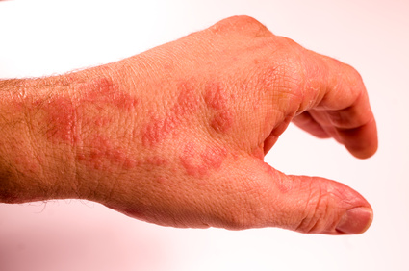
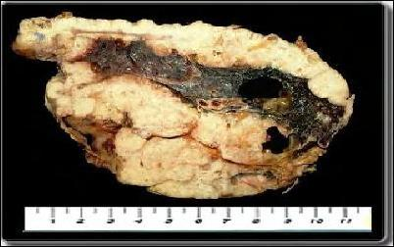
The Effects of a Hazard
ACUTE EFFECT – Skin Rash
Dose and Dose Effects
Dose – The amount of the material exposed to
Dose effects depend on the concentration
  Acute effect - Rapid Onset
  Chronic effect – Long Term
CHRONIC EFFECT - Mesothelioma
Notes:
Acute effects of exposure manifest themselves rapidly. The exposed individual typically has an immediate reaction.
The effects of chronic exposure may not be felt until long after contact or after long term exposure

Slide 66
Training Requirements
Explanation of HAZCOM Program
Postings
Understanding the
labeling system
Understanding SDS & How to Access
Location of chemicals being used
Specific hazards & protective measures needed
Observation & detection methods utilized for hazards
Notes:
Maintain a copy of the hazard communication program for employee review. Safety data sheets are a great source of information when conducting training on products.
All District employees must receive Hazard Communication training:
At the time of initial assignment.
Prior to working with any new chemicals or processes & being informed where chemicals are present in their work area.
Prior to performing non-routine task that involve chemicals.
All employee training must be documented
Use sign-in sheet to document training.
Keep training sign-in sheets on file for 3 years.

Slide 67
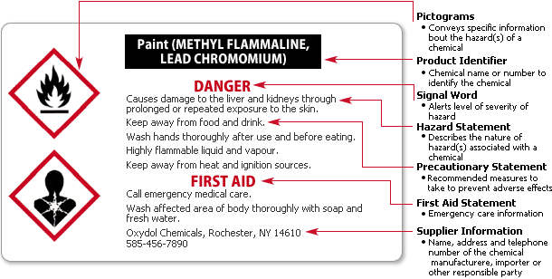
Labeling Requirements
Manufacturer’s Label will have the following info:
Product Identifier - Chemical identity
Signal Word
Hazard statement(s)
Pictogram(s)
Precautionary statement(s)
Manufacture’s info – including emergency phone number
Everyone is responsible for labels
Notes:
The new Globally Harmonized System (GHS) is a very rigorous standard that is going to require chemical manufactures to re-label and re-document all of their chemical products before the deadline date set for the countries they sell to. This re-documentation applies to product labels (including shipping labels on cartons and packages) and Safety Data Sheets (SDS). Both have to comply with the new GHS warning symbols, color codes, product identifiers, numbers, hazard statements, and precautionary statements.
Product manufacturers are required to provide this information on their label, it is recommended that all products be kept in their original container with the manufacturers label intact. If products must be transferred to a different container you must label the new container with the information shown above.

Slide 68
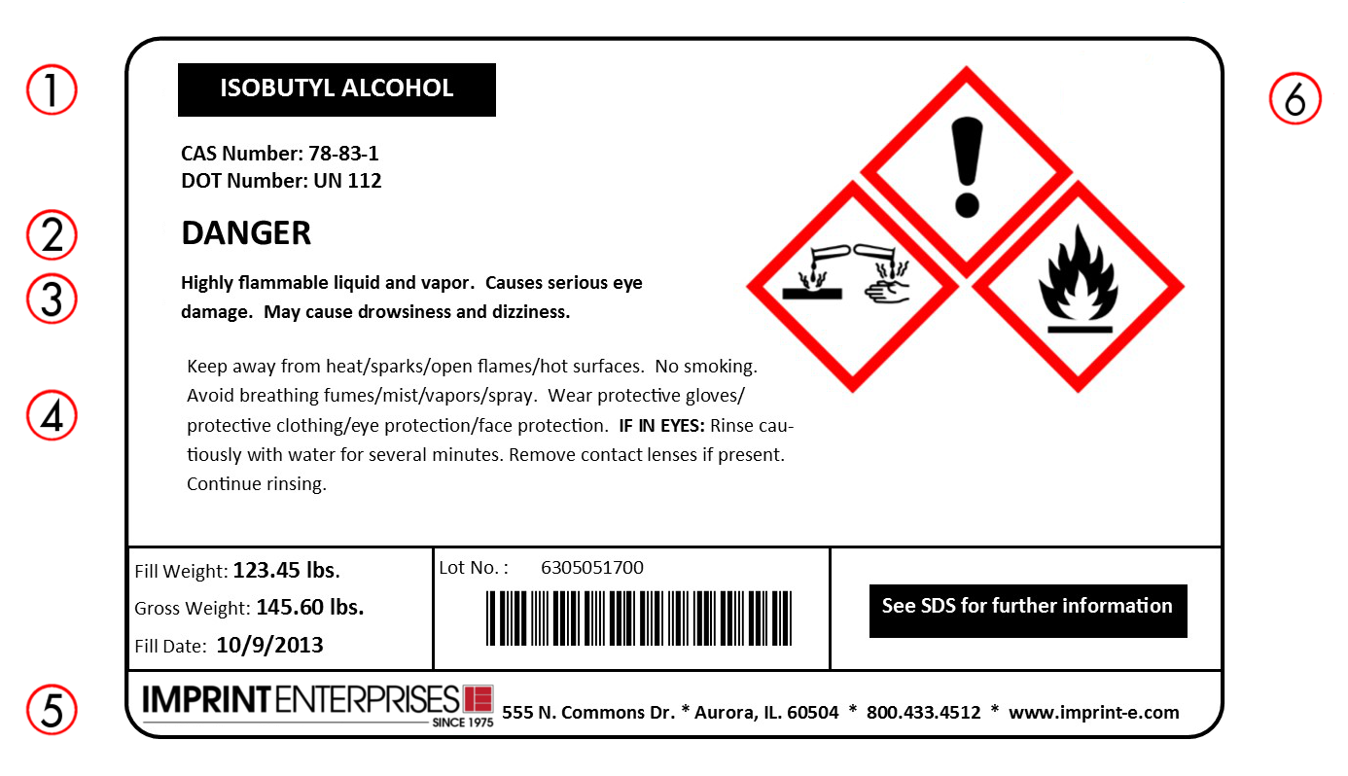
Labeling Components
Notes:
Product identifier
The name or number used for a hazardous chemical on a label or in the SDS. It provides a unique means by which the user can identify the chemical. The product identifier used shall permit cross-references to be made among the list of hazardous chemicals required in the written hazard communication program, the label and the SDS.
Signal Word
A word used to indicate the relative level of severity of hazard and alert the reader to a potential hazard on the label. The signal words used in this section are “danger” and “warning.” “Danger” is used for the more severe hazards, while “warning” is used for the less severe.
Hazard Statement
A statement assigned to a hazard class and category that describes the nature of the hazard(s) of a chemical, including, where appropriate, the degree of hazard. Example: “Highly Flammable Liquid”.
Precautionary Statement
A phrase that describes recommended measures that should be taken to minimize or prevent adverse effects resulting from exposure to a hazardous chemical, or improper storage or handling.
Supplier Identification
The name, address and phone number of the supplier or manufacturer.
Pictogram
A composition that may include a symbol plus other graphic elements, such as a border, background pattern, or color, that is intended to convey specific information about the hazards of a chemical. Eight pictograms are designated under this standard for application to a hazard category. You may see nine pictograms, however the “Environment” one is not mandatory. See the following page for examples.

Slide 69

P
I
C
T
O
G
R
A
M
What do the pictograms represent?
Notes:
As of June 1, 2015, the Hazard Communication Standard (HCS) will require pictograms on labels to alert users of the chemical hazards to which they may be exposed. Each pictogram consists of a symbol on a white background framed within a red border and represents a distinct hazard(s). The pictogram on the label is determined by the chemical hazard classification.
The following are the list of current pictograms that are shown above:
Environment – Means the hazard the chemical presents is aquatic toxicity
Exclamation Mark - Irritant (skin and eye), Skin Sensitizer, Acute Toxicity, Narcotic Effects, Respiratory Tract Irritant, Hazardous to Ozone Layer
Flame – Flammables, Pyrophoric, Self-Heating, Emits Flammable Gas, Self-Reactives, Organic Peroxides
Health Hazard – Carcinogen, Mutagenicity, Reproductive Toxicity, Respiratory Sensitizer, Target Organ Toxicity, Aspiration Toxicity
Gas Cylinder - Gases Under Pressure
Flame over Circle - Oxidizers
Exploding Bomb – Explosives, Self-Reactives, Organic Peroxides
Corrosion - Skin Corrosion/Burns, Eye Damage, Corrosive to Metals
Skull & Crossbones - Acute Toxicity (fatal or toxic)

Slide 70
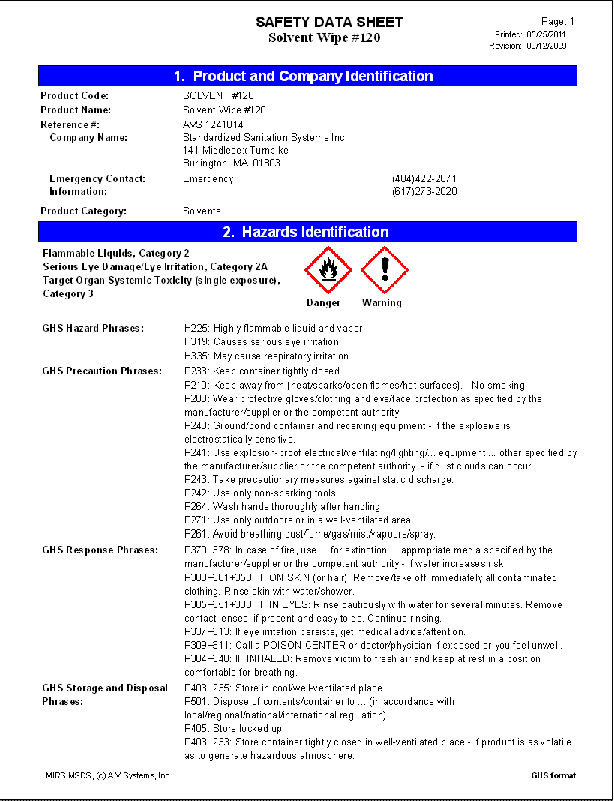
What are SDS
Safety Data Sheets (SDS)
The purpose of classification under the Globally Harmonized System (GHS) is to provide consistent information to users of chemicals with the goal of enhancing protection of human health and the environment
Notes:
Currently many different countries have different systems for classification and labeling of chemical products. In addition, several different systems can exist even within the same country. This situation has been expensive for governments to regulate and enforce, costly for companies who have to comply with many different systems, and confusing for workers who need to understand the hazards of a chemical in order to work safely.
Manufacturers are required by law to prepare SDS and make them available. Copies of SDS must be maintained on site for products used. Employees, their representatives & their physician have the right to request copies of SDS for the products they use or are exposed to. It is a good practice to ask for SDS’ when placing orders for products. Keep in mind that manufacturers may change formulations or update SDS’ due to changes in codes so always ensure that the SDS you have for a product is the most current SDS available.
Due to the complexity of and time needed for SDS training we have developed a separate PowerPoint to address how to read an SDS.

Slide 71
16 Categories on SDS
Globally Harmonized System mandates SDS’s have 16 standardized sections arranged in a strict order
1. Identification
2. Hazard(s) identification
3. Composition/information on ingredients
4. First-aid measures
5. Fire-fighting measures
6. Accidental release measures
7. Handling and Storage
8. Exposure controls/personal protection
Notes:
SDS Content
SDSs should provide a clear description of the data used to identify the hazards. The minimum information for each section listed should be included.
If specific information is not applicable or not available under a particular sub-heading, the SDS should clearly state this.
Some subheadings are national or regional in nature and SDSs should contain such information as is relevant for the area the SDSs are intended.
Section 1 - Chemical Product and Company Identification: has name of chemical & information on manufacturer including address and contact phone number.
Section 2 - Hazards Identification : identifies the hazards of the chemical and Symptoms of Overexposure
Section 3 - Composition/Information on Ingredients: List ingredients in the chemical, CAS # & percent of ingredient makeup.
Section 4 - First Aid Measures: What first Aid measures are needed if exposed to the hazard.
Section 5 - Fire Fighting Measures: Includes information on Extinguishing Media, Special Fire Fighting Procedures & Unusual Fire and Explosion Hazards.
Section 6 - Accidental Release Measures: What measures are needed if there is an accidental release/spill
Section 7 - Handling and Storage: How to handle the chemical safely, and safe storage requirements
Section 8 - Exposure Controls/Personal Protection: Explains what type of engineering controls and personal protective equipment is needed when using the chemical.

Slide 72
16 Categories on SDS
9. Physical and Chemical Properties
10. Stability and reactivity
11. Toxicological information
12. Ecological information
13. Disposal considerations
14. Transport information
15. Regulatory information
16. Other information
Notes:
Keep in mind that many of the categories are similar to what current SDS include however the categories must be in a certain order.
Section 9 - Physical and Chemical Properties: Includes Boiling Point, Solubility in Water, Vapor Pressure, Percent Volatile, Coefficient of Water/Oil Distribution, Flash Point & Pour Point.
Section 10 - Stability and Reactivity: This section contains information on how stable is the chemical and if it reacts to other chemicals and conditions to avoid.
Section 11 - Toxicological Information:
Section 12 - Ecological Information: Are there ecological issues associated with this chemical.
Section 13 - Disposal Considerations: How to safely dispose of the chemical.
Section 14 - Transportation Information: What are the shipping requirements, including the packing of the chemical and shipping mode; air, ground or ocean.
Section 15 - Regulatory Information: The regulatory requirements including but not limited to, CERCLA, SARA TITLE III, EPA Toxic Substances Control Act (TSCA).
Section 16 - Other Information: Any other information that may not have been included in other sections. Example, HMIS Hazard Rating:
Health – 1 (slight hazard), Fire Hazard – 4 (severe hazard), Reactivity – 0 (minimal hazard)

Slide 73
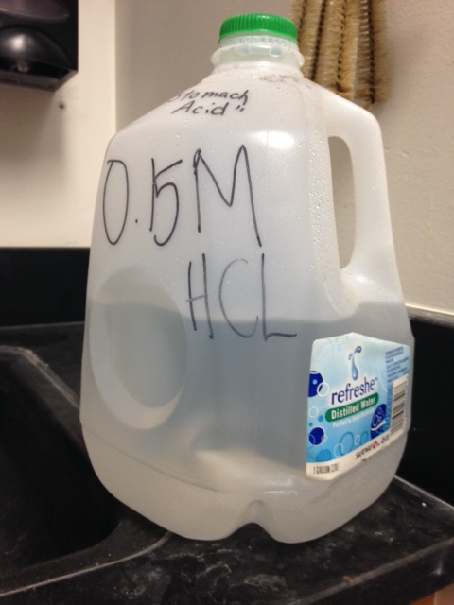
Chemical Containers
Do not place chemicals in food or beverage containers
  They are not designed for chemical storage
  Container may breakdown because of chemical reaction
  Some chemicals have similar appearance as a food or beverage
Hydrochloric Acid poured into water container

Slide 74
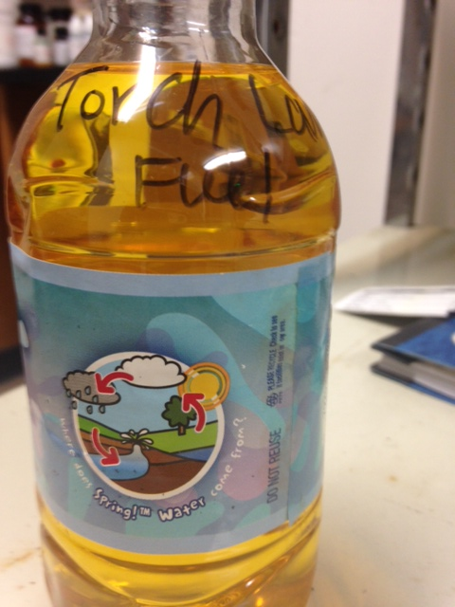
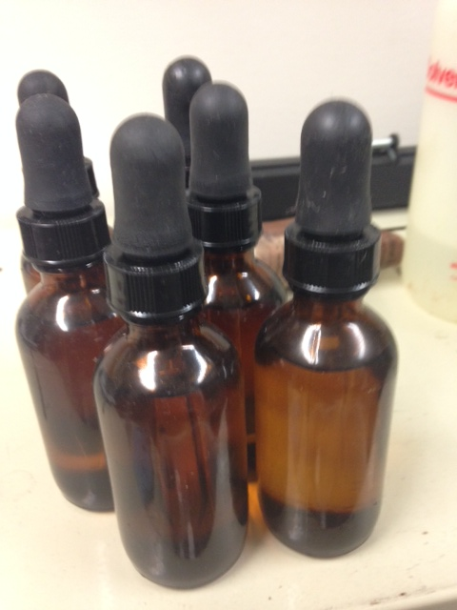
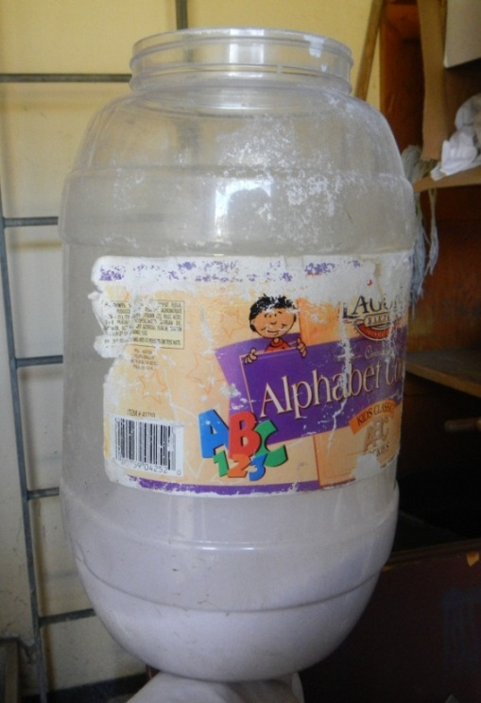
Can You Identify the Product?
1
2
3
Notes:
Picture # 1 – Is torch lantern fuel found at a HS being placed in a water bottle.
Picture # 2 – Unknown contents in numerous small bottles found in science classroom.
Pictures # 3 – Unknown white powder substance in a food container that was in a custodial area at an elementary school.
Its never ok to store chemicals in a food/beverage container.

Slide 75
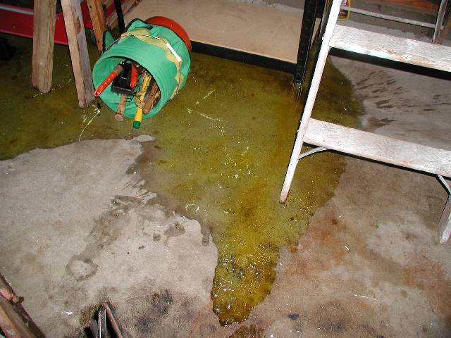
Hazardous Materials Spills
In the event of a chemical spill:
Evacuate and prevent access to area
Notify the site administrator
Do not ask untrained individuals to clean up
Call the Safety Office (858) 627-7174
If after hours call School Police
Notes:
After evacuating the area make sure that the doors of the affected area are closed and people are posted at them to prevent anyone from entering.
Be prepared to describe to the Hazmat personnel the substance spilled and the extent of the spill.
Never attempt to clean a spill when you do not know what the material is or if you have not been trained to do so. Secure the area, block access & contact the safety office for guidance and/or assistance. If a spill occurs after hours or on weekends please call school police. In emergency situation call 911.

Slide 76
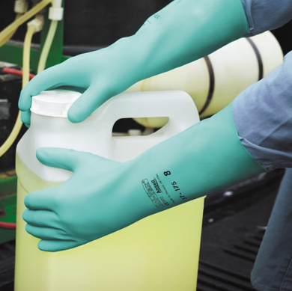
Summary
Wear personal protective equipment
Understand labeling requirements
Know storage and waste requirements
Know what to do in an emergency
Understand and follow the safety rules

Slide 77
Topic 4
Fire Extinguishers

Slide 78
Fire Extinguisher
Monthly Inspection
Notes:
Fire extinguishers are required to be checked each month. The following procedures are required by code.

Slide 79
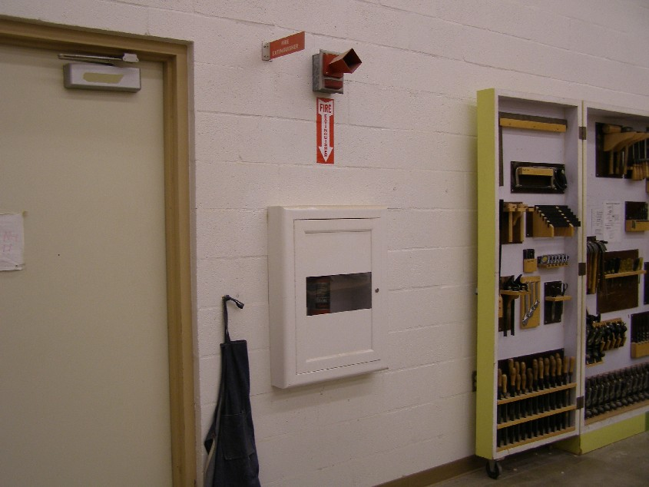

Location & Access
Verify the fire extinguishers are in their intended location and are not blocked or covered
#1
Notes:
Fire extinguishers should be visible and not blocked or covered by items.

Slide 80
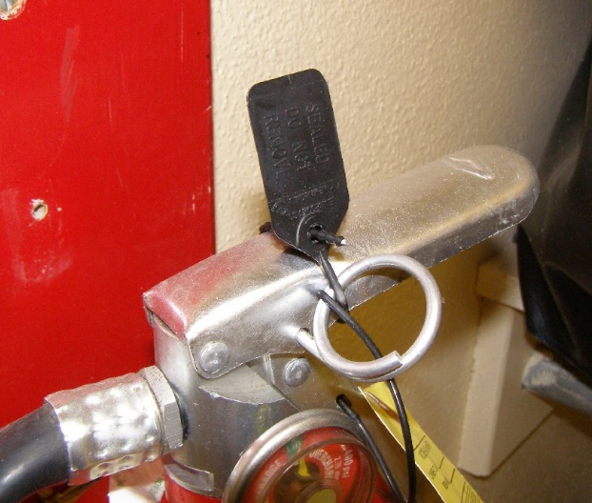
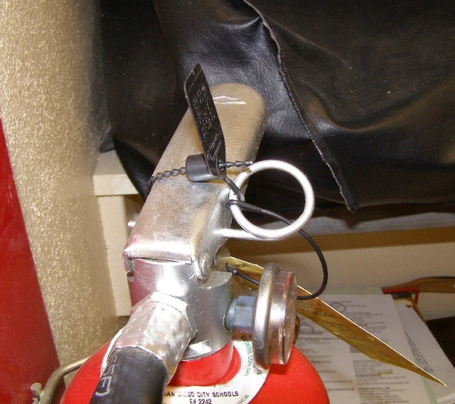
Visual Inspection
Inspect safety seals & tamper indicators to ensure they are not broken or missing
Notes:
Ensure that the extinguisher is in good condition.

Slide 81


Visual Inspection
Is the pin in place?
Notes:
There should be a plastic tamper seal keeping the pin in place.

Slide 82
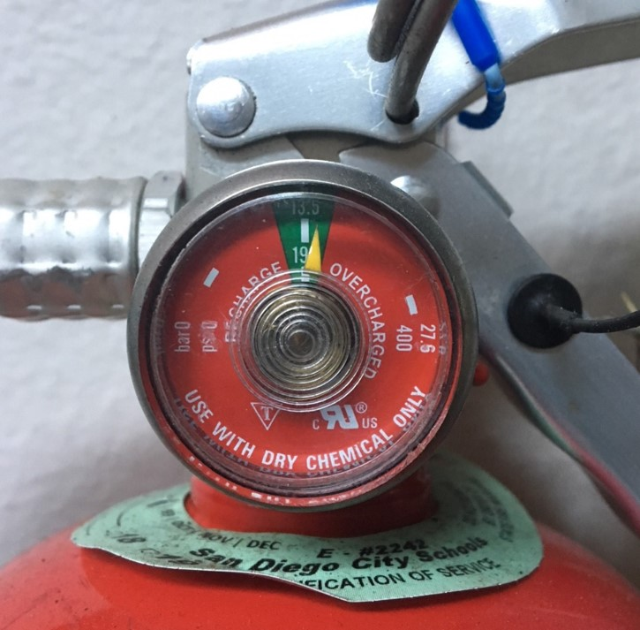
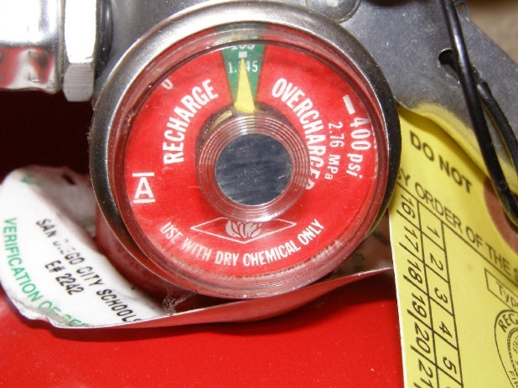
Indicator Gauge
Make sure the pressure gauge is in the operable range “Green Zone”
Notes:
Extinguishers are cylinders with powder extinguishing agent and nitrogen as a propellant. The pressure gauge gives you a visual indication as to whether or not the extinguisher is adequately charged with propellant.

Slide 83
Physical Condition
Determine fullness by hefting (lifting) the extinguisher
Determine extinguisher fullness by hefting (lifting) the extinguisher

Slide 84
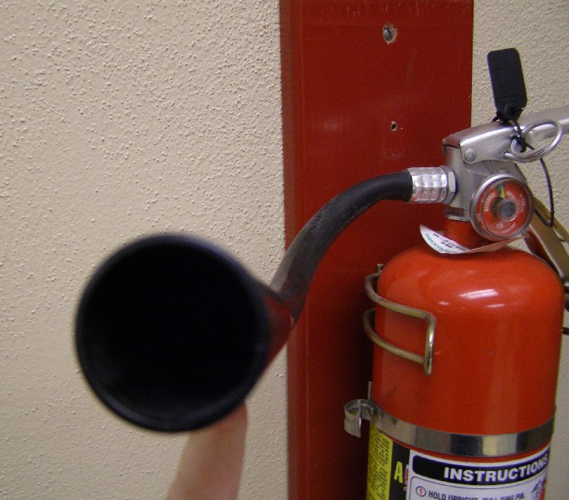

Hose/Nozzle
#5
#6
Inspect hose/nozzle clear of obstructions
Inspect hose/nozzle for any obstructions
Clear Nozzle
Blocked Nozzle
Notes:
Students can and will place trash, gum & other materials into the nozzle which can impact performance.

Slide 85
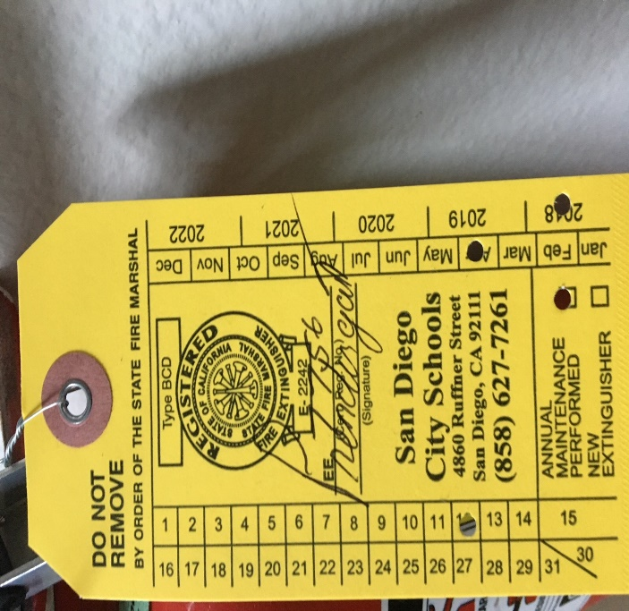
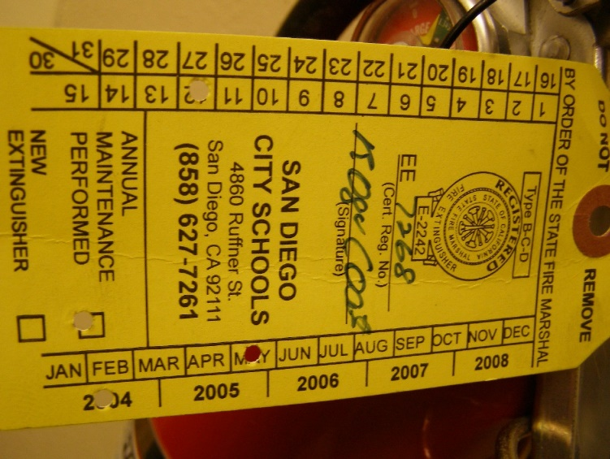
Inspection Tag
Check to see if tag is current. Tag indicates when extinguisher was last serviced by trained technicians. This is done annually.
#7
Current
Out of Date
Is it current?
Notes:
Code requires that extinguishers be serviced annually by trained technicians. The tag is designed to readily indicate when the extinguisher was last serviced by extinguisher technicians by use of a hole punch to indicate the year, month & day of service.

Slide 86
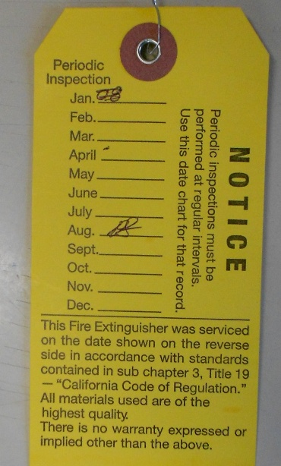
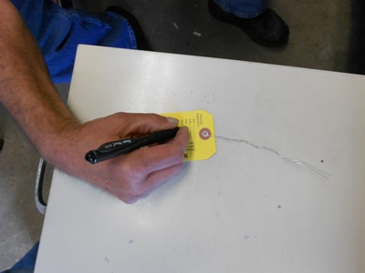
Check-Off
Initial back of tag
Initial back of tag
#8

Slide 87
Summary
Fire Extinguisher Monthly Quick Check
Unit is in proper location.
Unit is easily visible and accessible.
Safety seals in place and snug on pin.
Gauge is in the green and unit appears full when “hefted”.
Overall condition of unit looks undamaged.
Initial the tag and report any problems to:
Maintenance Department

Slide 88

For questions contact the Safety Office
Safety is about doing the right thing even if no one is looking because Safety starts with you!
858-627-7174
or
safetyoffice@sandi.net
or
Safety Management website
https://www.sandi.net/staff/safety-management/safety-management

